Slide 1


Dealio 2.0: MVP Architecture

Slide 2
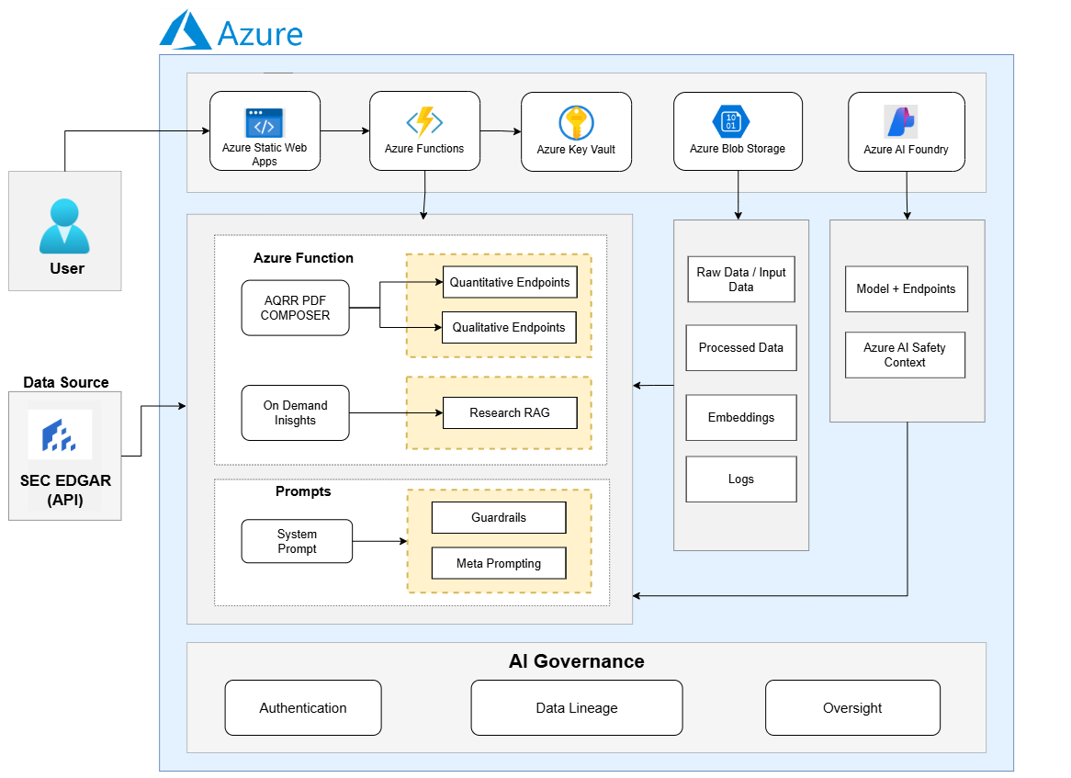
Dealio MVP – The current architecture
Summary Section

Slide 3
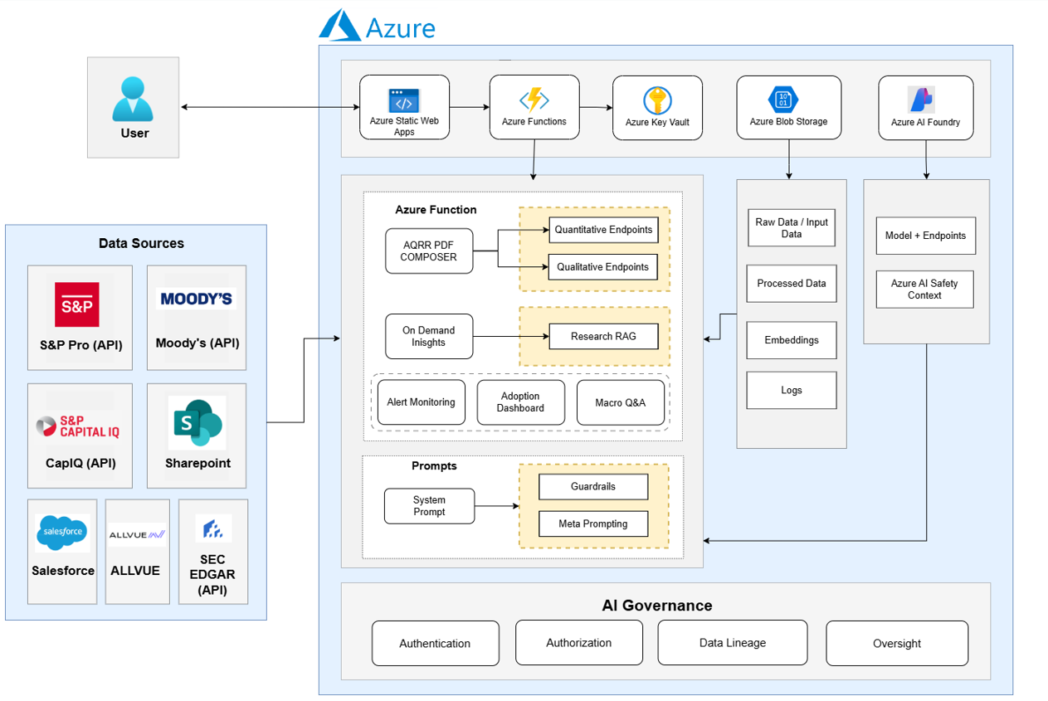
Dealio Architecture – Future Adoption
Summary Section

Slide 4
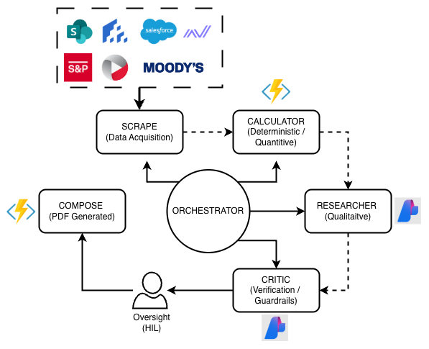
Multi Agent Orchestrator

